Slide 1

PatchManager
PATCH. VERIFY. PROVE IT.
COMMERCIAL PROFILE
One tool. The whole estate. Every layer.
No dedicated patch platform yet? The Commercial profile patches the OS, Office, browsers and every third-party app in one pass — with the fleet-safe behaviours a shared network needs.
Full-coverage patching for a whole estate
Public beta v1.5.1 · MIT licence
Notes:
This deck is for an estate with no dedicated patch management platform yet. The Commercial profile is the full-coverage answer: PatchManager owns everything, plus the fleet behaviours — throttling, jitter, rings — that make it safe at scale.

Slide 2
THE PROBLEM
Without a platform, patching doesn't scale
NO CONSISTENCY
Each machine patched on its own schedule, or none.
Every device becomes someone's manual chore.
NO VISIBILITY
No record of what's patched fleet-wide, or what's overdue.
No Intune, no SCCM, no RMM — just a fleet of Windows machines, each drifting out of date at its own pace, with no consistent record of what's actually patched.
NO SAFETY NET
A whole fleet hitting the network, or rebooting, at once.
Notes:
Set up the need. Without Intune, SCCM or an RMM, patching a fleet by hand doesn't scale — someone has to touch every machine, for every app, on some cadence, and it never quite happens consistently. That's the gap Commercial profile closes in one move.

Slide 3
THE PROFILE
One script owns every layer
Commercial profile patches the OS, Office, browsers and third-party apps — the full stack — deployed identically to every machine, with a report proving the result.
Patch
Verify
Prove it
Every provider, on by default — nothing left for a platform you don't have.
Confirms each result by re-reading the installed version, machine by machine.
One report per device, rolling up into a single fleet-wide view.
No agent. No service. No licence — a single .ps1 file plus a JSON config, deployed however you already reach the fleet.
Notes:
Introduce Commercial as the full-coverage answer: one script, deployed the same way to every device, patches every layer and writes the proof. Land the deployment simplicity — no agent, no service, no licence — because that's what makes it viable without a platform budget.

Slide 4
EVERYTHING, ONE PASS
Coverage
Windows Update
WinGet
Microsoft Store
Microsoft 365
OS quality & security
All upgradable packages
Store & MDM bridge
Click-to-Run
Chrome / Edge
Chocolatey / Scoop
Runtimes
Vendor updaters
Native updaters
Package managers
.NET, Python, Node.js
Extensible catalogue
OEM firmware
End-of-life
Patched by default
Opt-in (Dell/HP/Lenovo)
Report-only · endoflife.date
Opt-in
Report-only
Notes:
Breadth is the whole pitch here — every default is on, because there's no other system to hand anything to. Green is patched; amber is opt-in (OEM firmware); blue is report-only evidence, like end-of-life and staleness.

Slide 5
BUILT FOR THE FLEET
Fleet-safe by design
One machine can patch freely. A fleet sharing a network and a helpdesk needs more care — Commercial profile adds it automatically.
Bandwidth throttling
Jittered scheduling
Deployment rings
BITS transfers are capped so patch downloads don't crowd out everyday traffic — reverted automatically when the run ends.
A hostname-seeded delay spreads the fleet across the maintenance window, instead of one thundering herd.
Registry-driven Pilot / Early / Broad rings via GPO, so changes stagger rather than land on every device at once.
Same protections as a managed platform — without needing one.
Notes:
Because Commercial owns the whole fleet, it adds behaviours a single machine doesn't need: bandwidth throttling so patch traffic doesn't choke the network, and jittered scheduling so devices don't all hit the network or reboot window at the same moment.

Slide 6
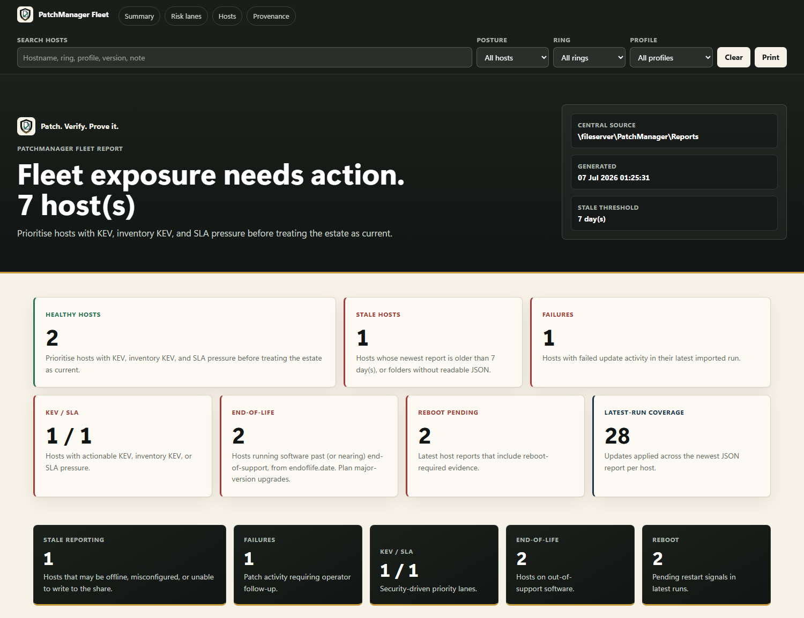
PROOF
One dashboard, the whole estate
Every device writes the same evidence — patched, verified, timestamped — and every report rolls up into one fleet view.
HTML
Interactive per-device report — search, filter, print.
JSON
Machine-readable results for automation.
CSV
Flat export for SIEM, Excel or Power BI.
Point reports at a central share and the fleet dashboard builds itself — stale hosts, KEV exposure and SLA breaches, estate-wide.
Notes:
Every device writes the same report format, and every report rolls up into one fleet dashboard — the single 'is my estate actually patched' view. Point to the sample. This is the difference between hoping the fleet is patched and knowing it.

Slide 7
OPERATIONAL SAFETY
Safe by default
Dry-run first
Pre-flight checks
Preview every change before anything runs.
Disk, battery, pending reboot, connectivity.
THE LINE WE DON'T CROSS
It never reboots a machine.
Reboot-required is flagged in the report and exit code 3010 — the restart decision stays with the estate owner.
System restore point
Maintenance windows
Created before patching begins on every device.
Patch out of hours; defer while a device is in use.
Notes:
Owning the whole stack raises the stakes, so safety is non-negotiable: dry-run first, pre-flight checks, a restore point, and the rule that never bends — it never reboots a machine on its own. The restart decision always stays with the estate owner.

Slide 8
THE RECOMMENDATION
Full coverage, fleet-safe rollout, zero licence cost.
Every layer, owned
Safe at scale
Costs nothing
OS to third-party apps — no gap left for a platform we don't have.
Throttling, jitter and rings — built for a shared fleet, not just one PC.
MIT-licensed, no agent, no service — deploy with what we already have.
PATCH. VERIFY. PROVE IT.
Notes:
Close on the value case for an estate without a platform: one script gives full coverage, fleet-safe rollout, and proof — for zero licence cost. Propose a short pilot on a small device group before scheduling the whole fleet.

